Slide 1
Exercise: Migrating from one SQL Server to another in Amazon RDS
In this exercise, you will migrate from one SQL Server database to another in Amazon Relational Database Service (Amazon RDS).
Migrating process:
Create target SQL Server database instance in Amazon RDS.
Create a replication instance in AWS Database Migration Service (AWS DMS)
Create source SQL Server database instance in Amazon RDS.
Create source and target endpoints for your database migration.
Create replication task in AWS DMS.
Complete the migration and clean up resources.
Migrating from Microsoft SQL Server to Amazon RDS https://www.aws.training/Details/eLearning?id=59021
https://aws-tc-largeobjects.s3-us-west-2.amazonaws.com/CurationMoveToManaged/Course2-Migrate-MicrosoftSQL-to-RDS-UserGuide.pdf

Slide 2
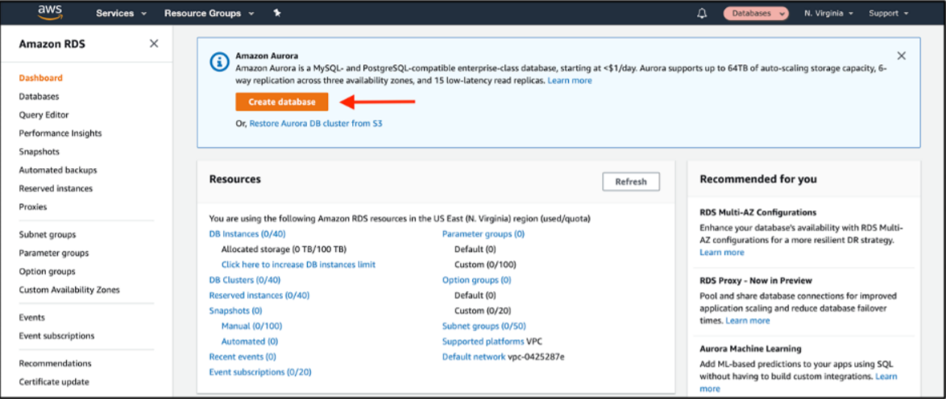
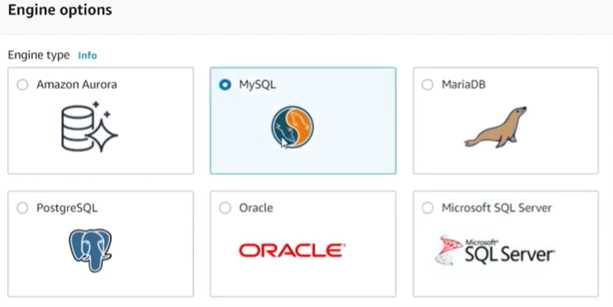
1. Navigate to the Amazon RDS console. On the main page, choose Create database to create a new database.
2. In the Engine options section, choose MySQL as the Engine type.

Slide 3
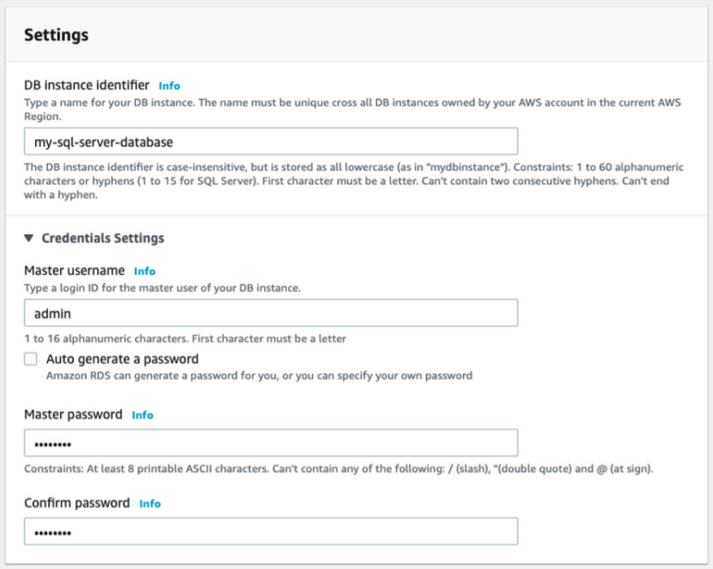
3. Choose the Production template. In the Settings section, give your database a name and set the master username and password

Slide 4
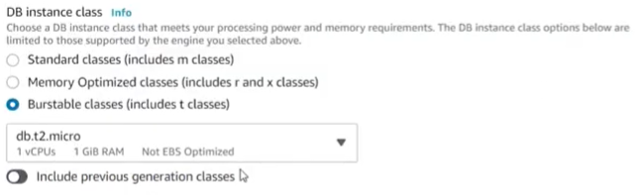
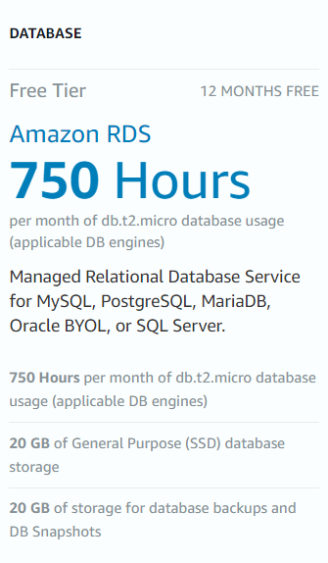
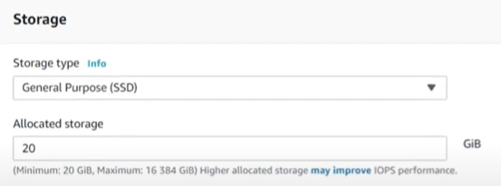
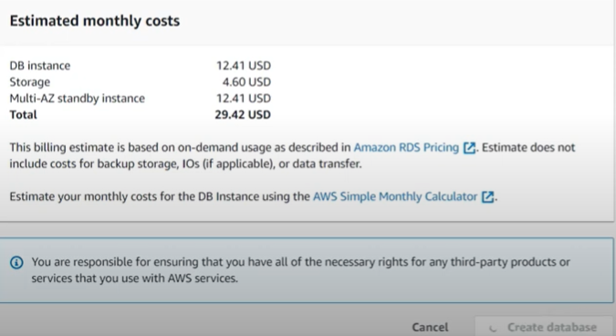
4. Choose the database instance size.
5. Choose Storage. Enable Storage autoscaling, if you want.
6. Estimated monthly costs is just for info. You have to fit in “free tier” requirements. So, push Create database.

Slide 5
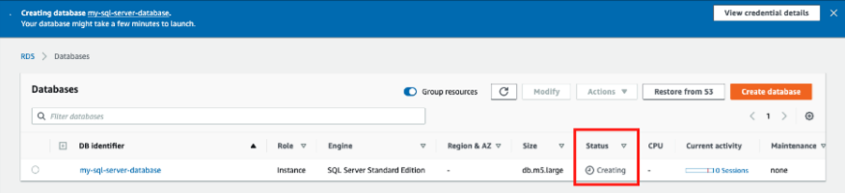
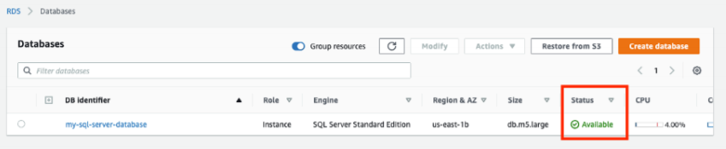
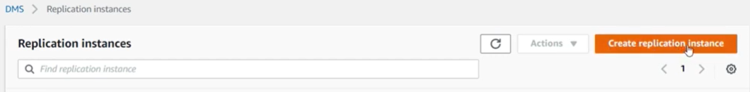
7. As Amazon RDS is provisioning your infrastructure and initializing your database, the status of your database is Creating.
When your database is ready to use, its status is Available.
8. In AWS DMS console go to Replication instances and Create replication instance

Slide 6
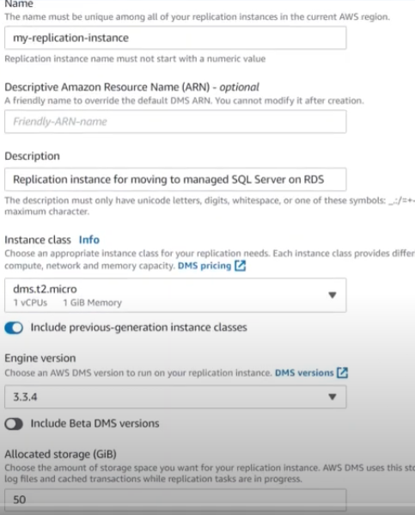
9. Then choose an engine version for AWS DMS. Finally, choose the amount of allocated storage for your replication instance.

Slide 7
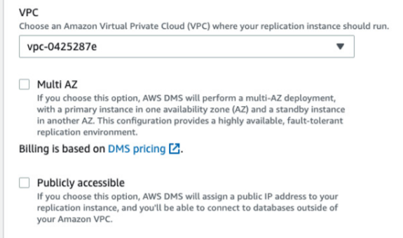
10. You may choose to have a Multi-AZ setup for your replication instance for redundancy. Finally, choose whether your replication instance should be publicly accessible.

Slide 8
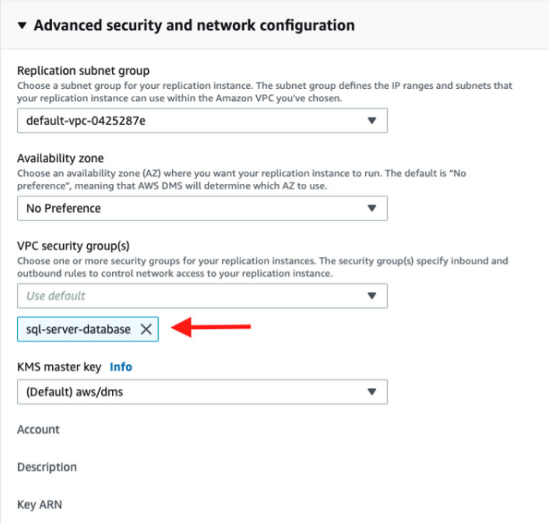
11. Open the Advanced security and network configuration section. For the VPC security group(s) configuration, choose the same security group that you attached to your Amazon RDS database. This allows your replication instance to access your Amazon RDS database.

Slide 9
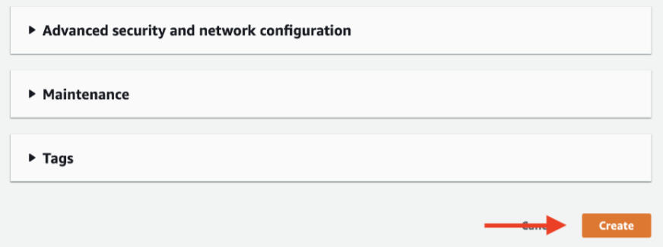
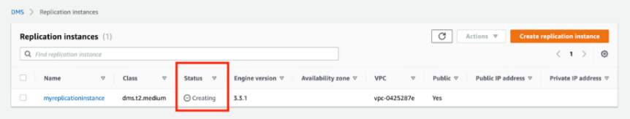
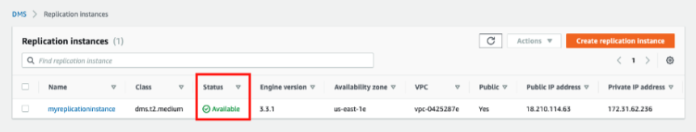
12. When you’re ready, choose Create to create your replication instance in AWS DMS.
13. After you choose Create, AWS provisions your replication instance. It shows a status of Creating while AWS provisions and initializes your instance.
When your replication instance is ready to go, its status is Available.

Slide 10
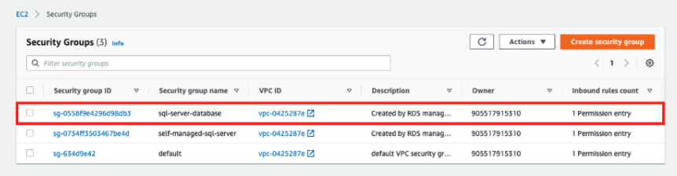
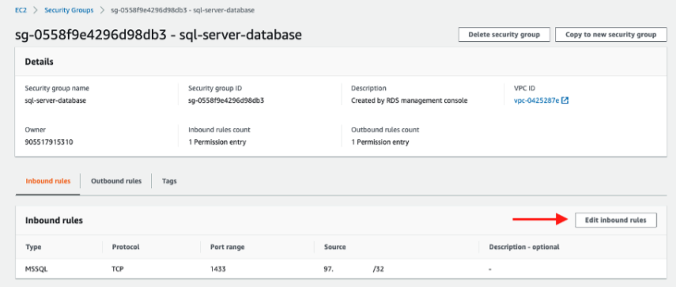
14. While you are waiting for your replication instance to be available, go to the Amazon EC2 console : Security Groups section.
In the Security Groups section, find the security group you attached to your SQL Server database instance and your replication instance, and choose it.
15. Choose Edit inbound rules for your security group.

Slide 11
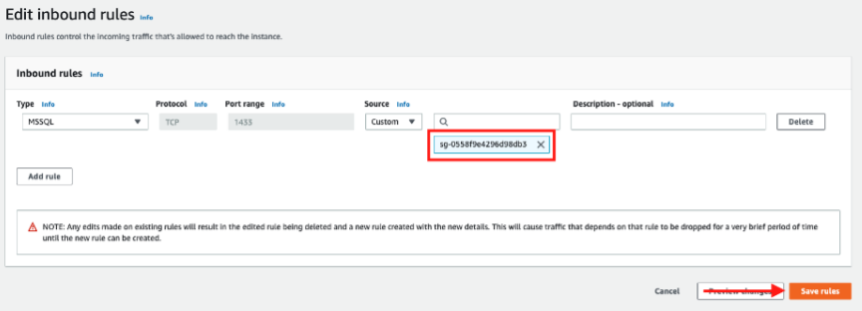
16. Your security group has an existing rule that allows for access to your SQL Server instance from the IP address you used to create the database. Remove the existing IP address and enter the name of the security group used for your Amazon RDS database instance and replication instance. Your screen should look as follows.
17. Choose Save rules to save the updated rules for your security group.

Slide 12
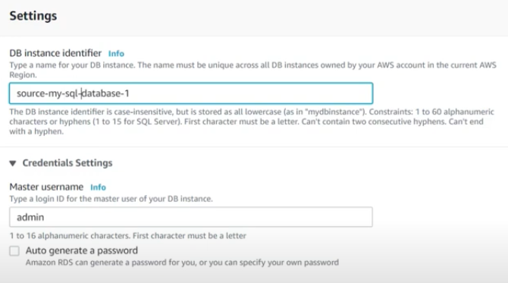
18. Create source SQL Server database instance in Amazon RDS (see steps 1-7).

Slide 13
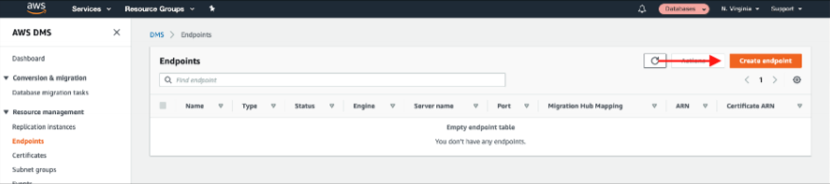
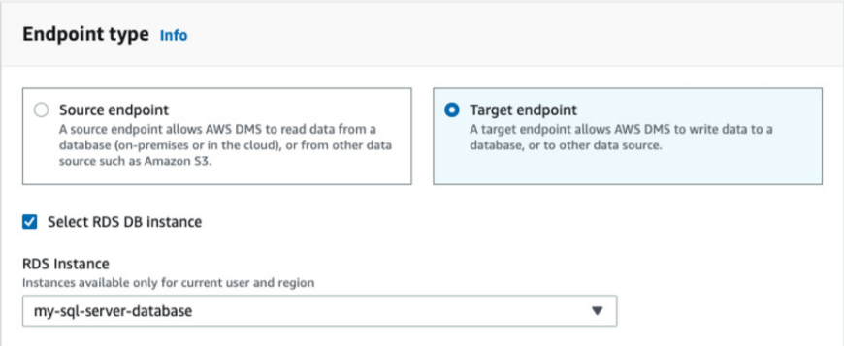
19. In this step, you create source and target endpoints for a replication task in AWS DMS. An endpoint describes the connection address, credentials, and other information required to connect to a database. In the next step, you use these endpoints to create a replication task that copies data from your source database to your target database.
First, let’s create the endpoint for your target database. Navigate to the Endpoints section of the AWS DMS console. Choose Create endpoint to create a new endpoint.
20. In the endpoint creation wizard, choose to create a Target endpoint. Choose the check box to Select RDS DB Instance, and choose your target Amazon RDS database in the dropdown.

Slide 14
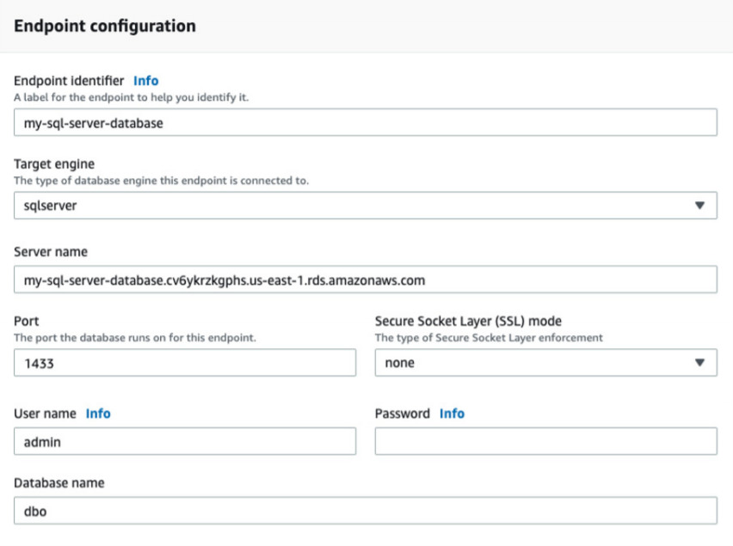
21. You need to enter your password and a database name near the bottom of the section.

Slide 15
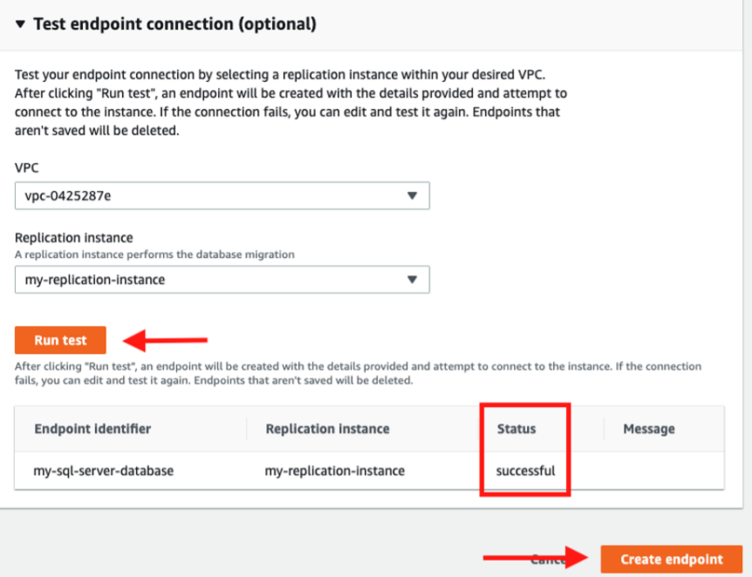
22. Before you save your endpoint, you should test the connection to ensure it was configured correctly. Open the Test endpoint connection section to test your connection.
Choose the replication instance you want to use, and then choose Run test. After a few seconds, you should see a status of successful. This indicates you configured your security group and endpoint correctly. Choose Create endpoint to save your endpoint.

Slide 16
23. Follow steps 19-22 to create an endpoint for your source database. Unlike the target database, you need to complete the connection endpoint, port, and credentials yourself.
Before moving on to the next step, you should have two endpoints configured: one for your source database and one for your target database. Make sure that you have tested both endpoints and can successfully connect to both databases. Then move on to the next step.

Slide 17
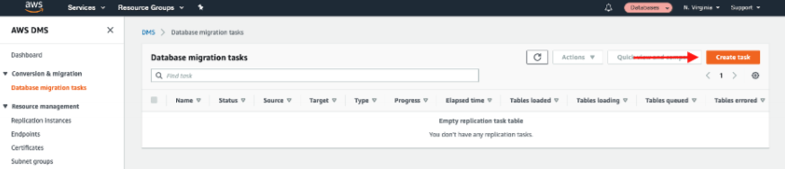
24. In this step, you create a replication task in AWS DMS. A replication task copies the data from your source database to your target database. To get started, navigate to the Replication tasks section of the AWS DMS console. Choose Create task to create a new replication task.
25. In the Task configuration section, set up the parameters of your replication task. Give your task a name and choose the replication instance you created in an earlier step. Then choose the source endpoint for your existing database and your target endpoint for your fully managed database in Amazon RDS.
You need to choose a migration type. There are two migration types:
1. Migrate existing data, which performs a one-time process to copy data from your source database to your target database.
2. Replicate data changes, which copies all ongoing operations from your source database to your target database.
If you are migrating your application from using a self-managed database to using a fully managed database, you want to use both types. The first type copies all data in your database, and the second type ensures that all additional updates are replicated to your new database until you switch your application to use the new database. For the migration type, choose Migrate existing data and replicate ongoing changes. Note that this requires you to have logical replication enabled on your source database.

Slide 18
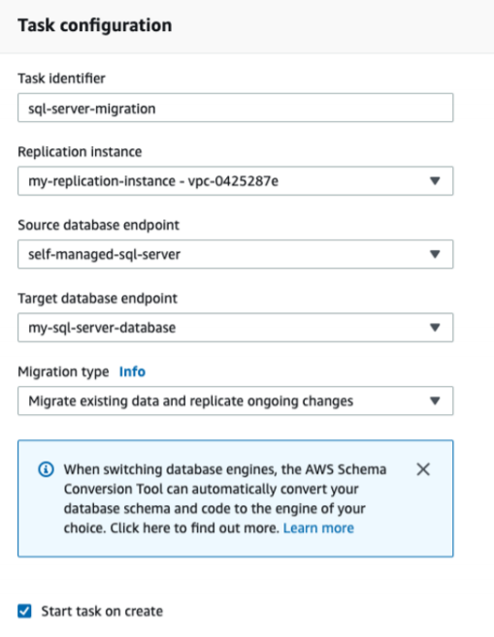

Slide 19
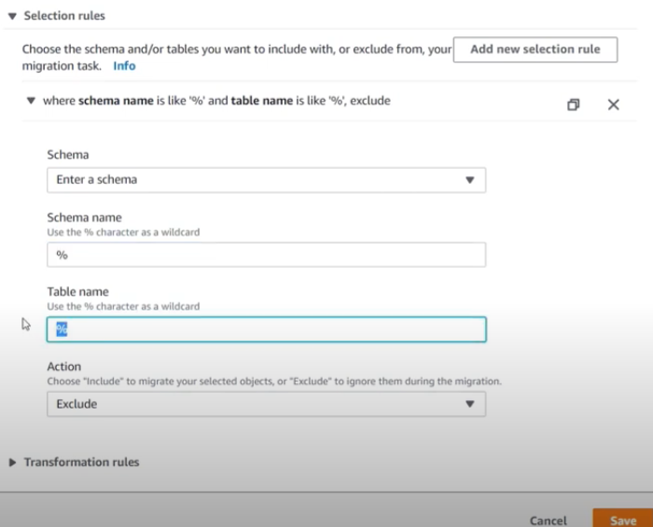
26. In the Table mappings section, tell AWS DMS which tables you want to copy. Enter the name of the schemas and tables you want to copy. You can use % as a wildcard character to copy multiple tables or schemas.
Action: you can leave Exclude, because it is not important in these Exercise

Slide 20
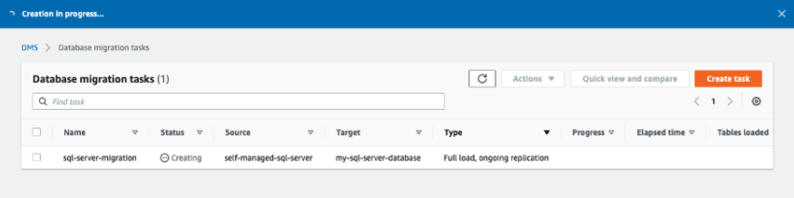
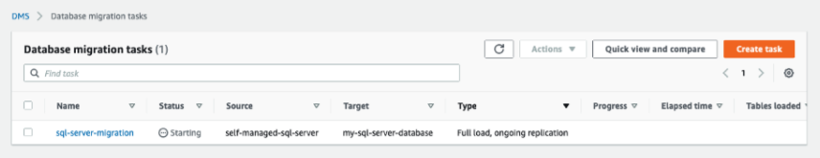
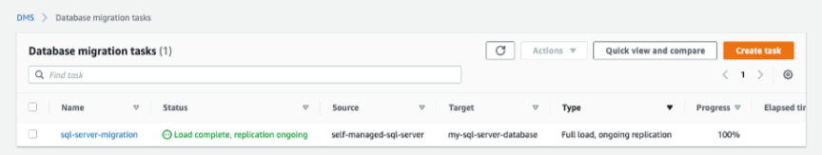
27. When you are ready, choose Create task to start your replication task. After you create your task, your task is shown in the Database migration tasks section with a status of Creating.
28. After the task is initialized, its status is Starting
29. After the migration of existing data is complete, it shows a status of Load complete, replication ongoing.

Slide 21
27. When you are ready, choose Create task to start your replication task. After you create your task, your task is shown in the Database migration tasks section with a status of Creating.
28. After the task is initialized, its status is Starting
29. After the migration of existing data is complete, it shows a status of Load complete, replication ongoing.

Slide 22
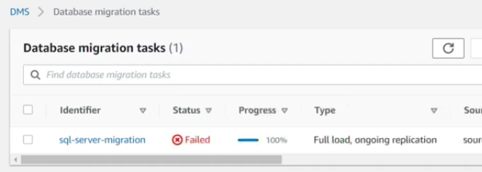
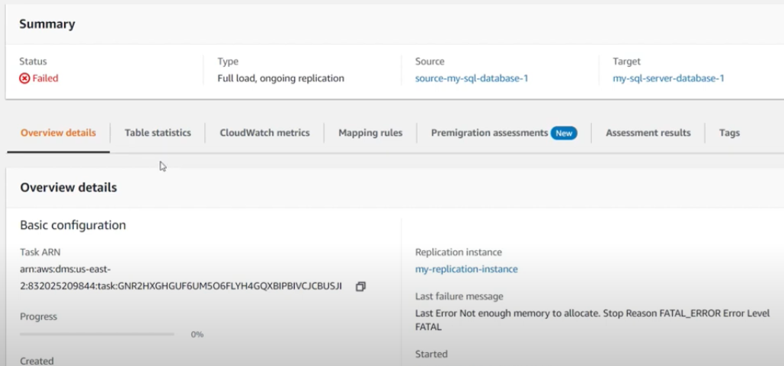
27. Then you will get Failed status, because instance has not enough memory.

Slide 23
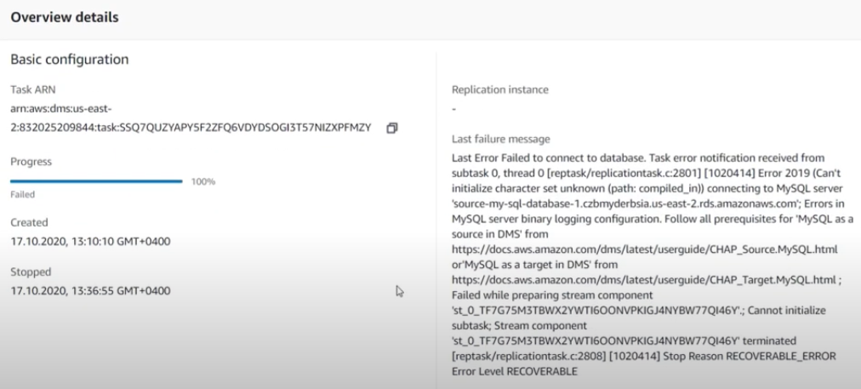
27. If you get problems with database connections

Slide 24
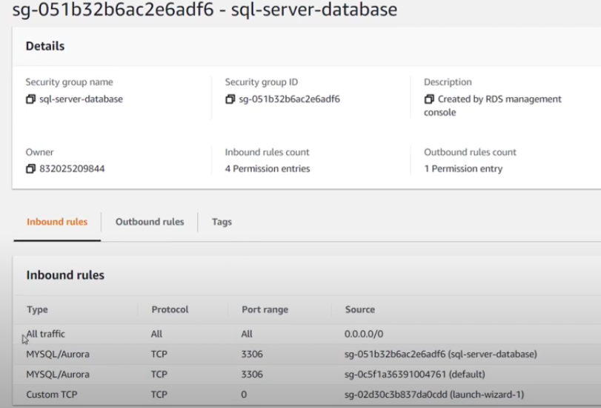
… you can add security rule which allow access from every address. Of course it is less secure.

